Slide 1
Sentiment Analysis
By Jayasurya
BRITISH AIRWAYS

Slide 2
Agenda
1
What sentimental Analysis is?
2
Steps involved and the models implemented
3
Results and Discussion

Slide 3


Step1 : Web Scraping
The data has been retrieved from ‘SKYTRAX’ which contains the reviews for different type of airlines
Notes:
https://pixabay.com/photos/architecture-building-amsterdam-1448221/

Slide 4
Step1 : Web Scraping
All the necessary packages are used such as beautiful soup, requests etc
using Pandas package, a total of 1000 reviews are collected and stored as a data frame
Notes:
https://pixabay.com/photos/architecture-building-amsterdam-1448221/

Slide 5

Step2 : Data Cleaning
This steps involves using all the techniques to clean the data ,this includes removing any unwanted symbols or texts that can potentially impact our sentiment score that is calculated in the end
All the packages from the nltk package has been downloaded
Regular Expressions are used to remove several elements from each in the data frame
The reviews are converted into token after removing the stop words
Stop words are the commonly used words in the English language. It is to be noted that we are performing sentiment analysis for English reviews.

Slide 6
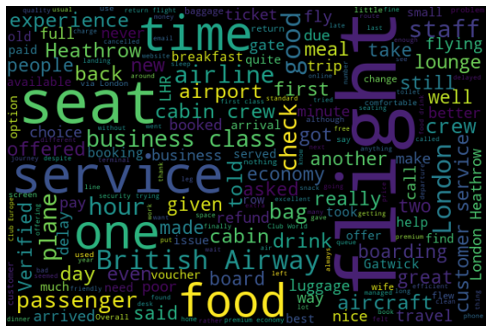
STEP3 : EDA
Used Word cloud package to check the most commonly occurring word, the below image is the example of the word cloud

Slide 7
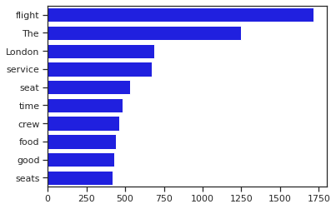
The below figure is a graphical representation of the most frequently occurred words in our analysis.
Notes:
https://pixabay.com/photos/room-flower-white-cabinet-plant-4161931/

Slide 8
Weused Vander’s Sentimental Analysis approach. VADER ( Valence Aware Dictionary for Sentiment Reasoning) is a model used for text sentiment analysis that is sensitive to both polarity (positive/negative) and intensity (strength) of emotion. It is available in the NLTK package and can be applied directly to unlabeled text data.

Slide 9
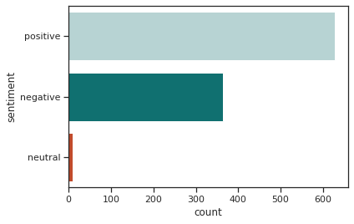
The below is the bar graph that contains the positive, negative and neutral analysis for our British airways reviews. The proportion of positive, negative and neutral reviews are 62.8%, 36.3%, 0.9%

Slide 10
Conclusion
It is clear that more than 70% of the reviews are neutral and positive combined
Around 35% of the reviews are negative
Few example of negative words are ‘failed’, ‘missing’, ‘incompetent’, ‘unacceptable’, ‘messed’, ‘confused’, ‘unfortunate’, nightmare’ etc.

Slide 11
Thank You

